Slide 1

Most Dangerous Countries for Women 2024
Women's Safety Abroad: A Country-by-Country Breakdown.
Somnath Roy (22CS011197)
Soumo Chandra (22CS011200)
Shrestha Purohit (23CS2012016)
Soham Dutta (22CS011193)
Subham Mahish (22CS011188)
Supervised by :
Tanaya Das
Assistant Professor,
JIS University.

Slide 2
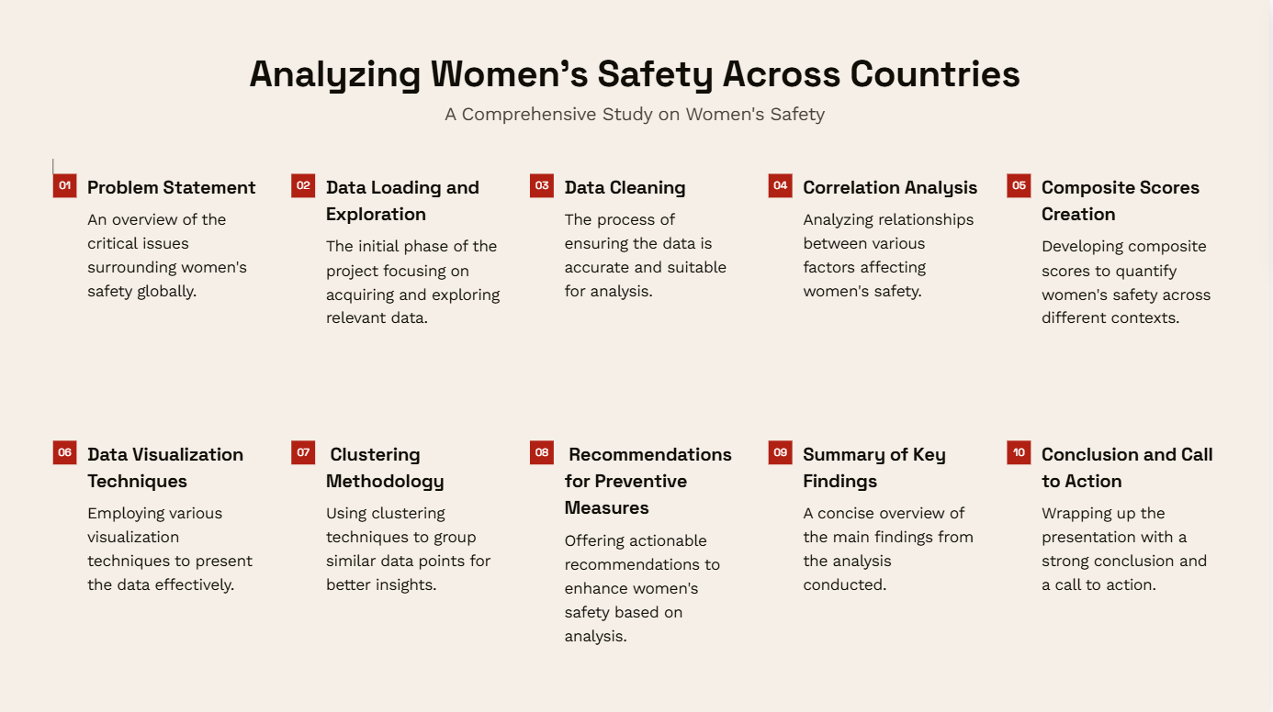

Slide 3
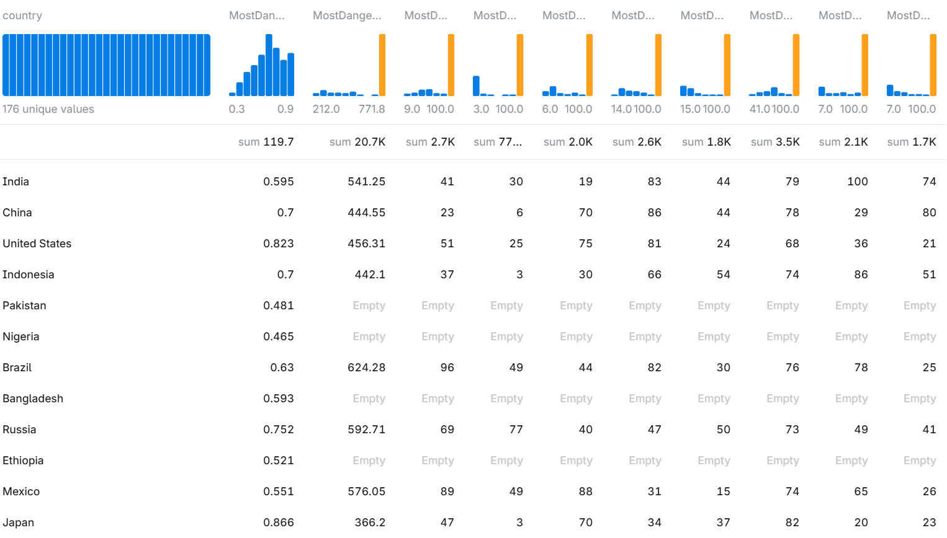
Dataset Visualization
Exploration of the dataset is the foundational step to understand the structure, identify missing values, assess data quality, and discover initial insights.
Here is a visual representation of the dataset.
Tools used: Alpha Tably for Visualization, Python 3 (

Slide 4
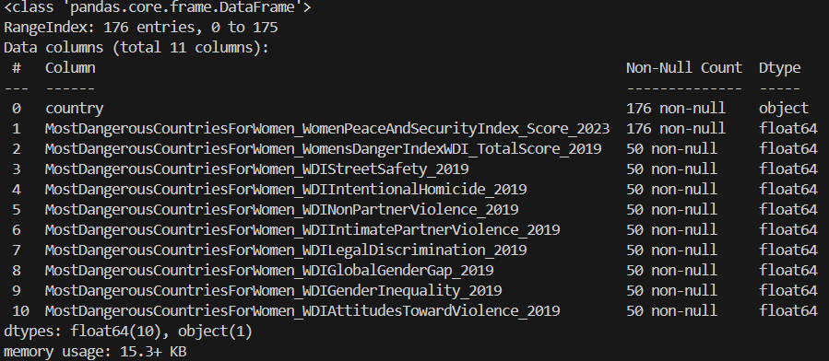
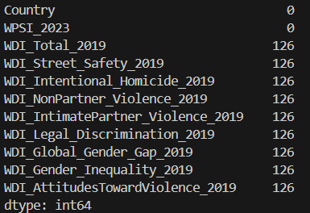
Data Cleaning: Ensuring Data Integrity
Checking for missing Values and
Dropping them if needed.
Basic descriptive statistics to get an overview of each numeric column.

Slide 5
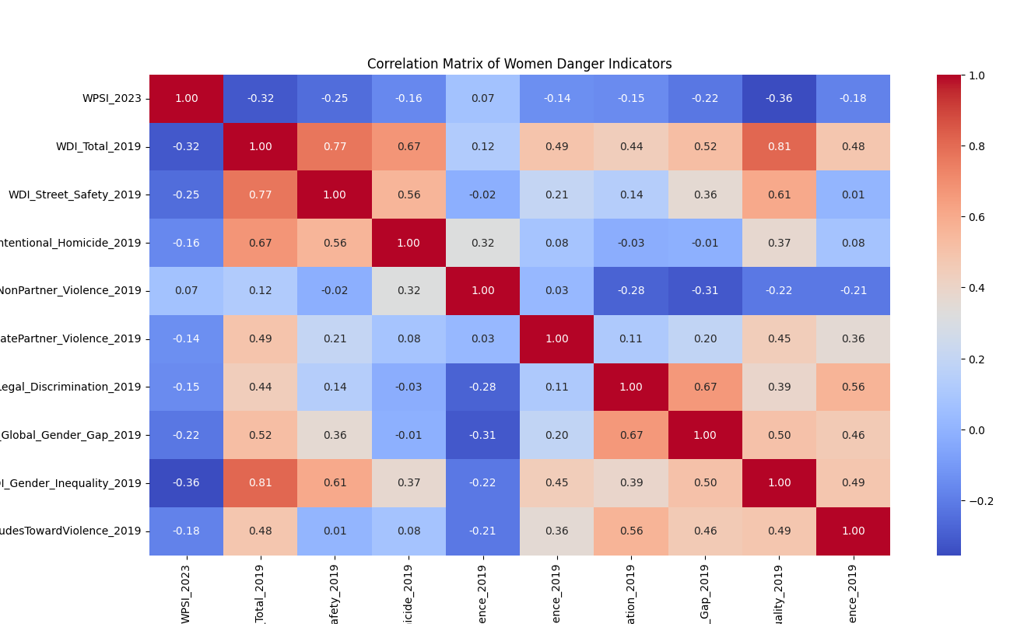
Correlation Analysis: Understanding Relationships
Significant Correlations
High Positive Correlations (Dangerous Factors):
Homicide Rates ↔ Danger Scores Countries with high homicide rates tend to have higher overall danger scores.
Legal Discrimination ↔ Gender Inequality Countries with discriminatory laws show higher gender inequality.
High Negative Correlations (Protective Factors):
Street Safety ↔ Gender Inequality Societies with higher gender equality often report better street safety.
Women Peace and Security Index ↔ Danger Scores Peaceful societies score better on women’s safety.
Correlation analysis helps identify relationships between variables, providing insights into how different factors contribute to women's safety or danger in various countries.

Slide 6
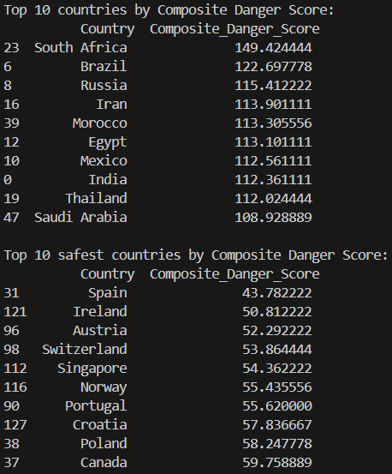
Composite Scores Creation: Quantifying Danger
Interpretation of Scores
Composite Danger Score: Highlights countries where violence, discrimination, and inequality are prevalent.
Composite Safety Score: Highlights countries with strong legal protections, societal safety, and equality.
Why Use Composite Scores?
Holistic Measurement: Captures multiple dimensions of danger and safety.
Actionable Insights: Identifies areas requiring intervention.
Simplification: Provides a single measure for comparison across countries.

Slide 7
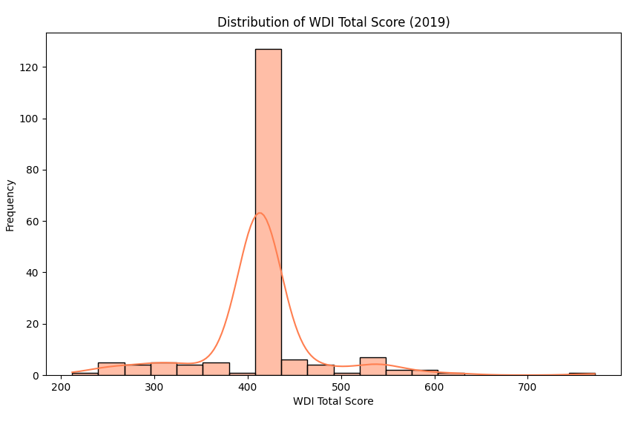
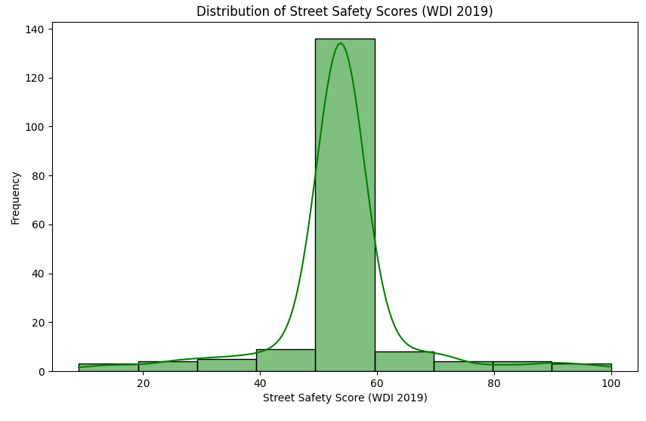
Data Visualization by Plotting using Python
Street Safety Distribution
Purpose: Understand the overall distribution of street safety scores across countries.
Visualization: Histogram with KDE (Kernel Density Estimate).
Danger Score Distribution
Purpose: Highlight countries with high danger scores.
Visualization: Histogram with KDE (Kernel Density Estimate).

Slide 8
Cluster Methodology
Clustering is an unsupervised machine learning technique that groups data points based on their similarities.
1. Grouping Countries by Risk Profile
Purpose: Divide countries into clusters (e.g., low-risk, medium-risk, and high-risk).
Benefits:
Simplifies complex data by summarizing it into categories.
2. Visualizing Relationships
Plotting clusters (e.g., using a scatter plot) makes it easier to understand how countries differ based on danger indicators like Street Safety, Legal Discrimination, and Gender Inequality.

Slide 9
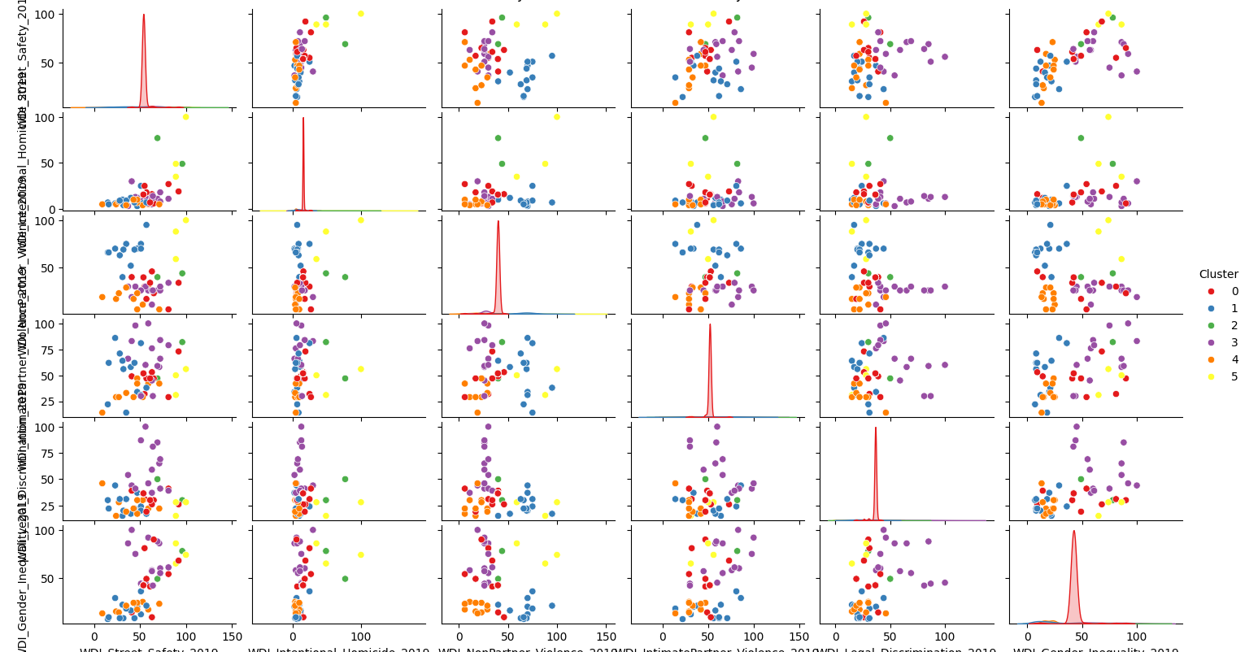

Slide 10
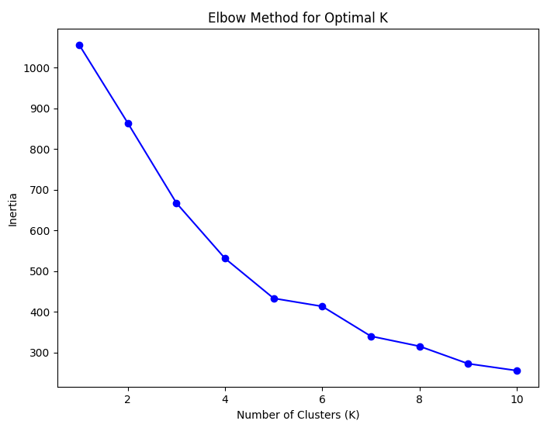
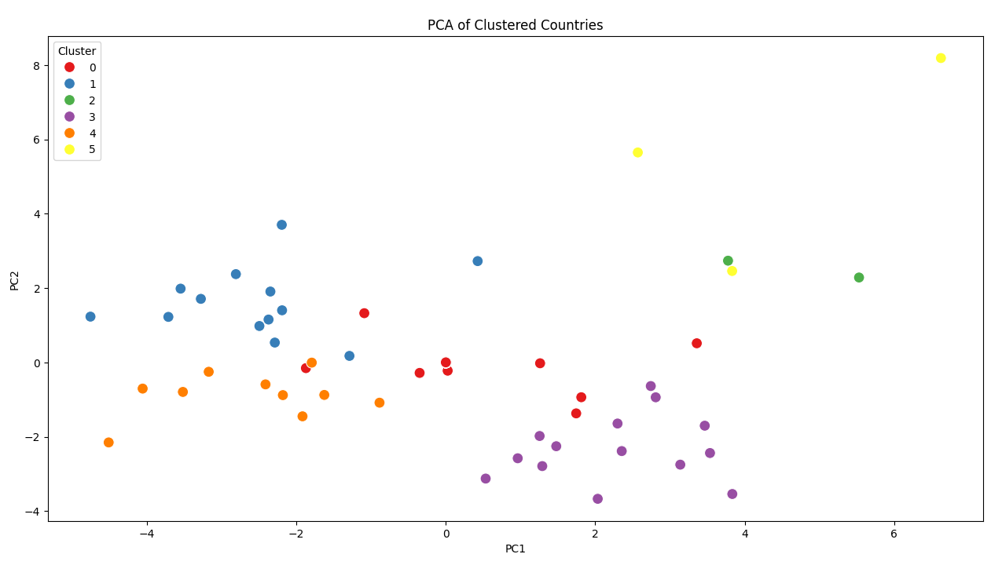
Elbow Curve and PCA of Cluster
How They Work Together
Elbow Curve: Determines the optimal number of clusters.
PCA: Reduces data dimensionality for:
Easier interpretation.
Effective visualization of the clusters in low-dimensional space.
Improved computational efficiency for clustering algorithms.
Together, these tools ensure that the clustering process is both statistically sound and visually interpretable, making it easier to derive actionable insights from the data.

Slide 11
Recommendations for Preventive Measures
1. Strengthen Legal Protections :
Enforce stricter laws against gender-based violence, including domestic violence and harassment.
2. Promote Gender Equality :
Reduce gender inequality through education, economic opportunities, and political representation.
3. Improve Street Safety :
Enhance public safety through better street lighting, CCTV surveillance, and increased police presence.
4. Raise Awareness and Education :
Conduct campaigns to challenge harmful societal norms and attitudes that perpetuate violence against women.
5. Strengthen Support Systems :
Train healthcare and law enforcement personnel to handle gender-based violence sensitively and effectively.

Slide 12
Summary and Conclusion
This project analyzes the factors contributing to the safety and danger levels for women in different countries, using indicators such as Gender Inequality, Street Safety, Legal Discrimination, and more. By clustering countries and ranking them based on composite danger and safety scores, the project identifies high-risk nations and provides data-driven insights.
Key findings:
Countries with high danger scores often have poor gender equality and legal discrimination.
Safety scores are strongly linked to effective governance and progressive societal norms.
Clustering highlights distinct risk profiles, enabling tailored recommendations for each group.

Slide 13
Call to Action
For Governments:
Prioritize reforms in legal protections for women.
Allocate resources to enhance street safety and support systems.
For International Organizations:
Provide funding and technical assistance to countries struggling with gender-based violence.
Foster global awareness campaigns promoting women's safety and equality.
Conclusion
The analysis underscores the urgent need for legislative, societal, and infrastructure reforms to improve women’s safety globally. High-risk countries require immediate attention, while medium- and low-risk nations should maintain and refine their policies.

